Slide 1

Veneer
Terms

Slide 2
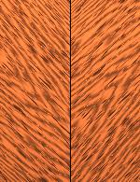
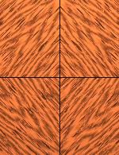
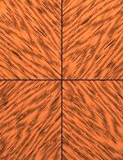
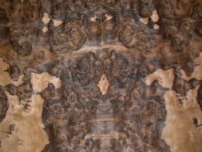
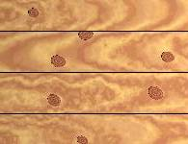
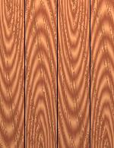
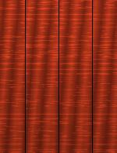
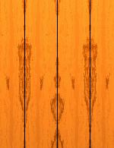
Correctly name the following
(a) (b) (c)
(d) (e)
(f) (g) (h)

Slide 3
Veneering Patterns
Herringbone Diamond Reverse Diamond
Burr Random
Inverted Running Book matched Slip matched

Slide 4
Explain the following Veneer Terms :
Marquetry:
Balancing Veneer :
Rotary Veneer:
Stripe Veneer :
Inlay :
Grain :
Birdseye :
Flitch :
Cross band :
Blue Stain :
Bleed Through :
Oyster Veneer :
Boulle Work :

Slide 5
Veneer Terms :
Marquetry : Creating patterns or pictures using different veneers.
Balancing Veneer : Back of groundwork is veneered also to prevent warpage.
Rotary Veneer : Veneer peeled from the log in long continuous sheets. Mainly used for backing veneer. ( note : Birds Eye Maple is a choice veneer )
Stripe Veneer : Also called Ribbon Figure obtained by cutting timber with interlocking Grain.
Inlay : Narrow strips of wood inlaid into the ground work.
Grain : The direction in which the wood fibres are going.

Slide 6
Birdseye : Figure on the surface of the veneer similar to small birds eyes.
Flitch : A section of a Log after initial conversion also refers to a bundle of Veneers cut from a single flitch.
Cross band : When the grain direction runs at right angles to panel edges.
Blue Stain : The reaction that certain timber has with Iron. Eg. the Tannic acid in Oak.
Bleed Through : Glue forced through the grain of the veneer. (Show through)
Oyster Veneer : Veneers cut at 45° across the branch of certain trees, Walnut.
Boulle Work: Charles Andrea Buhl used other materials besides wood veneer to create his Marquetry work.

Slide 7
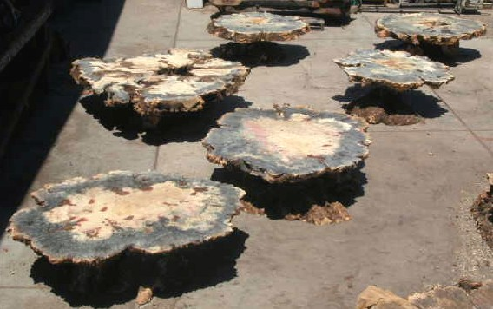




Burrs / Burls
Burrs are growths on the sides of trees. Veneers are obtained by slicing through them.

Slide 8
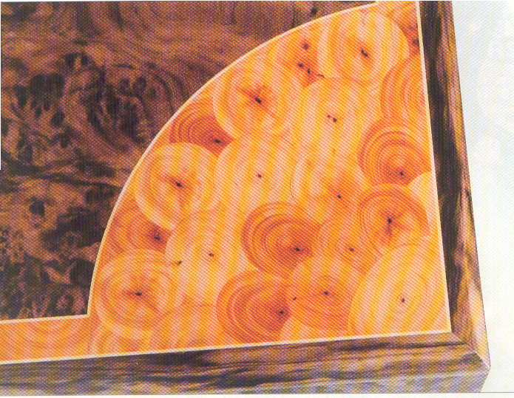
Oyster Shell Veneers
Thin Slices of veneer about 1.5mm are cut across the branch of Trees such as Lignum Vitae, Olive, Laburnum, Yew and Walnut.
The result is an Oyster – shell effect. The Oysters are stacked with wooden spacers between and weighted down or the short lengths of branches are buried in dry sand.
The Seasoning must be very gradual to avoid splitting. Oysters can be either trimmed Square and matched or laid at random.
This Table Top has American Burr Walnut inlaid with Sycamore inlay & Yew Oysters

