Slide 1
Timber
Conversion

Slide 2
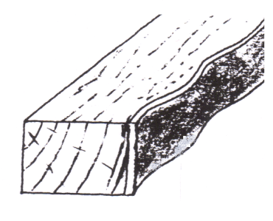
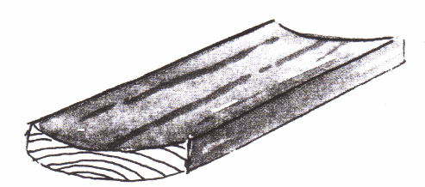
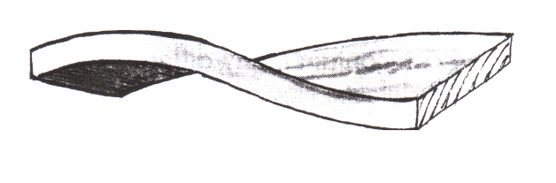
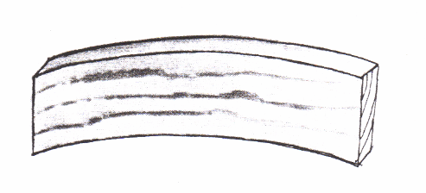
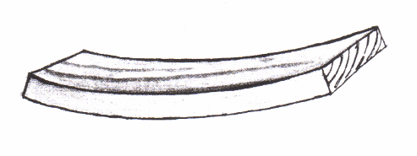
Manmade Timber Defects
What name is given to this defect?
Can you name each of the defects to these converted boards below.
__________________
__________________
__________________
__________________

Slide 3
Manmade Timber Defects
Waney edge : Converted timber having one or more edges not square or containing bark.
Badly stacked boards: Can result in
Cupping
Twisting
Springing
Bowing

Slide 4
Seasoning Timber Defects
What is Honeycombing?
What is Collapse?
What is Case Hardening ?
How do End splits occur?

Slide 5
Seasoning Timber Defects
Honeycombing : internal splits due to incorrect Kiln seasoning.
Collapse : Timber is dried too quickly water is sucked out before air has a chance to fill the cell and the cell walls collapse.
Case Hardening : The inner core remains wet while the outer case dries and hardens.
End splits : Untreated ends of timber will split from Moisture evaporation.

Slide 6
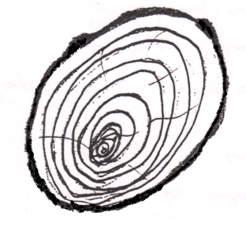
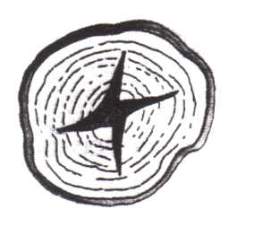
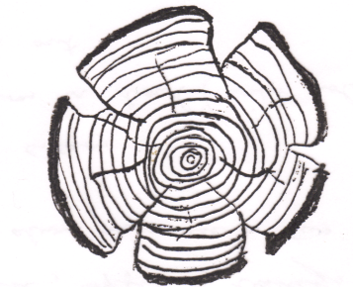
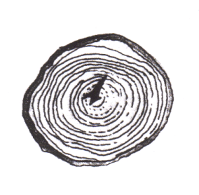
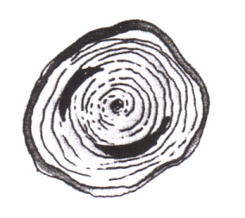
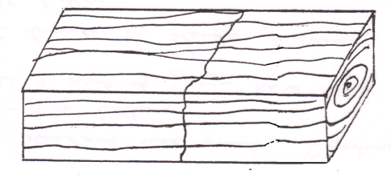
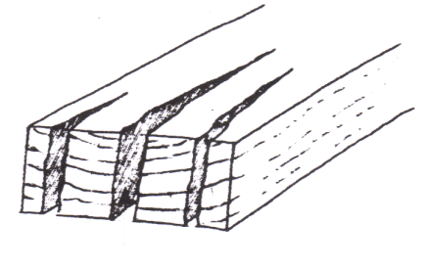
Name These Timber Defects
(a)
(b)
(c)
(d)
(e)
(f)
(g)
(h)

Slide 7
Name These Timber Defects
(a) Wandering
Heart
(b) Star Shake
(c) Radial Shake
(d) Heart Shake
(e) Cup Shake
(f) Thunder
Shake
(g) End Splits
(h) Waney Edge

