Slide 1
Knock Down
Fittings

Slide 2
Test Your Knowledge
Of
Knock Down Fittings.
See how many you
can name
correctly.
Start Slide Show.

Slide 3
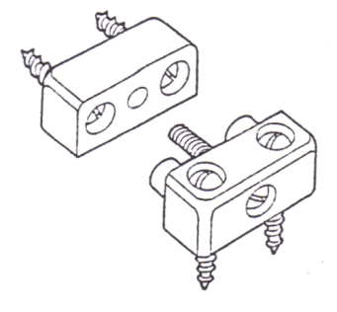
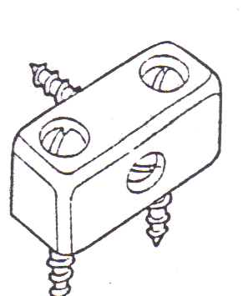
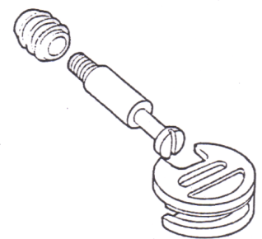
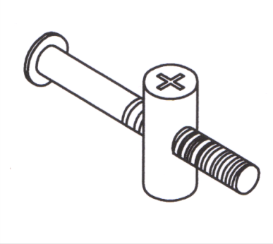
Block Joint : Hard plastic
Surface fitting, side to end
Modesty Block : Hard plastic. Surface fitting, side to end
Bolt & Cam : Metal & plastic
Recessed & concealed,
carcase and solid furniture
Bolt & Dowel : Metal
Recessed & concealed,
carcase and solid furniture

Slide 4
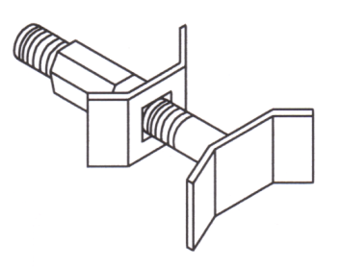
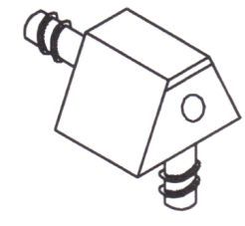
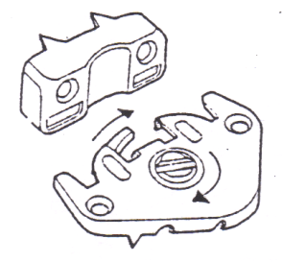
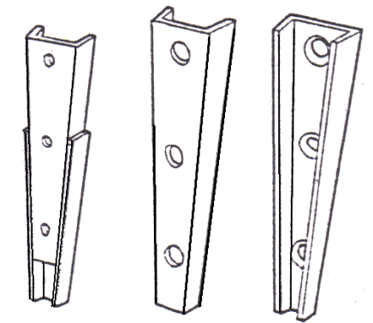
Panel Bolt Connector : Metal
Recessed, used for joining
two work tops end to end
Knock Down Dowel :
Hard plastic
Surface fitting, side to end
Hook Cam : Metal. Surface,
used for carcase work
on larger furniture
Taper connector :
Metal
Recessed used for
connecting
Bed ends, larger
furniture

Slide 5
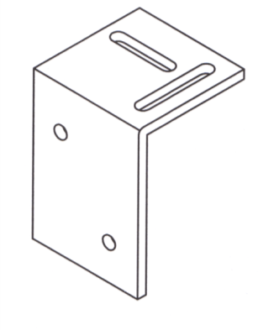
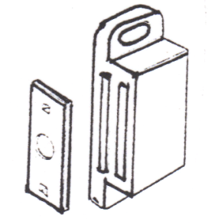
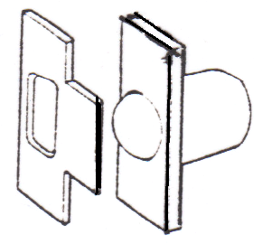
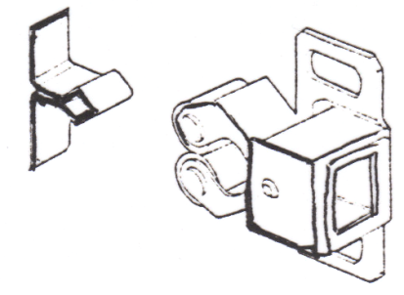
Shrinkage Plate : Metal
Surfaced or recessed used for connecting solid timber
Magnetic Catch : Metal &
plastic. Surface, used to
keep door closed
Ball Catch : Metal & plastic.
Surface, used to
keep door closed
Roller Catch :
Metal & plastic.
Surface, used to
keep door closed

Slide 6
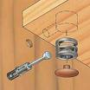
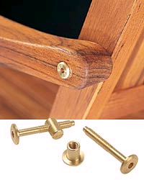
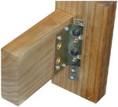

(Mini-fix) Bolt & Cam :
Recessed & concealed,
carcase and solid furniture
Brass Bolt & cross dowel:
Recessed & concealed,
carcase and solid furniture
Metal corner connector : Slotted screws

Slide 7


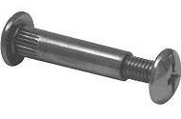
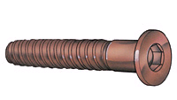
Slotted recessed
connectors
Keyhole Hangers
Connecting Screws :
Metal or plastic used for
joining carcases using
pre-drilled holes
Comfit Screws

Slide 8

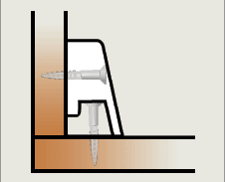
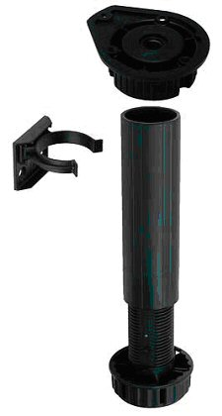
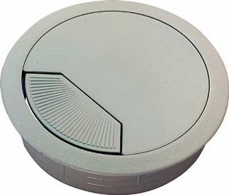
Lay on Hinges
Knock- Down Fitting
Insert for cable cut out
Carcase Legs

Slide 9
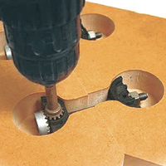
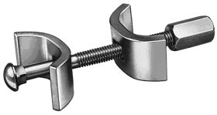
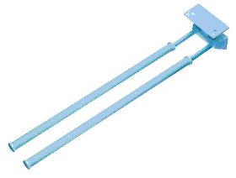
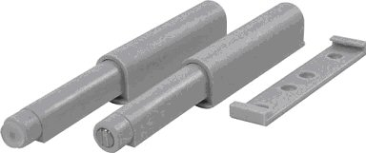
Panel Connecter
Easy closers
Plastic Towel holders

