Slide 1
Chisels

Slide 2
Quick Test
Play this presentation and see if you can correctly name each chisel before you click the words.
Don’t worry if you do not get them all correct first time you can always retake the test.

Slide 3
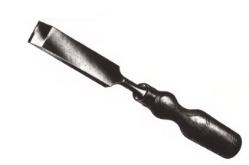
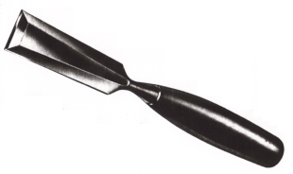
Firmer Chisels : blade 3 – 50mm wide and square in section, used for general work.
Bevel-edged Chisel : 3 - 50mm wide, the bevel allows working in corners less than 90º e.g. Dovetails

Slide 4
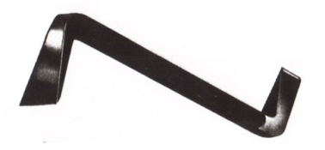
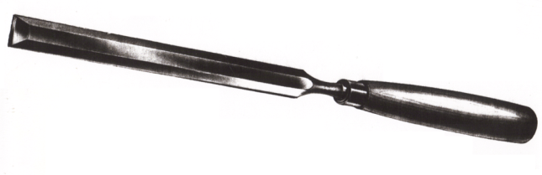
Drawer Lock Chisel : Used with a hammer in confined spaces like a drawer opening, to chop out for the receiver.
Bevel-edged Paring Chisel : Has a longer blade, used for paring wide housings.

Slide 5
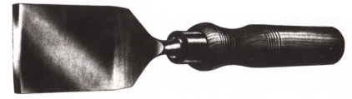
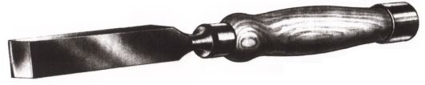
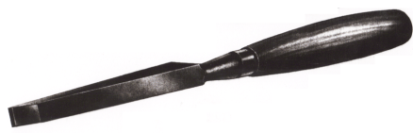
Butt Chisel : 6 – 50mm , short blade for cutting hinge housings.
Carpenters Mortise Chisel : with ferule made in heavier sections to withstand heavy blows from the mallet, used to chop out mortises.
Cabinetmakers Mortise Chisels : socket type tapered along the blade for strength

Slide 6
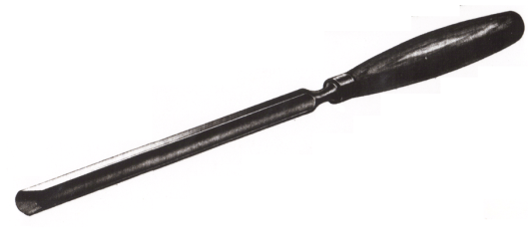
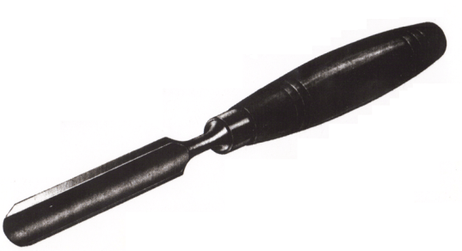
Paring Gouges : Long blade to reach across the wood. Sharpened on the inside face for paring out hollows on the face of the wood.
Firmer Gouge : 3 – 50mm wide. Outside ground gouge for convex curves or flutes, bevel down

Slide 7
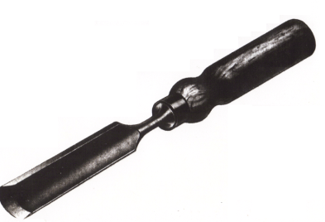
Scribing Gouge : 3 – 25mm wide. General purpose inside ground for concave curves, making Knuckle joint.

Slide 8
How many did you get correct?
Read the chisels notes again and then re-take the test, see do you do any better.

