Slide 1
Locks
Traditional Furniture Locks

Slide 2
Locks
Small finely made locks are fitted to furniture and boxes.
However, they do not provide total security, merely some degree of privacy, since most furniture locks can be forced.
For everyday storage, a simple catch avoids the inconvenience of having to use keys.
Locks are made in various sizes and quantities and are usually measured on length to the pin.
Locks for doors are made right or left hand, terms used to indicate the direction in which the bolt shoots.

Slide 3
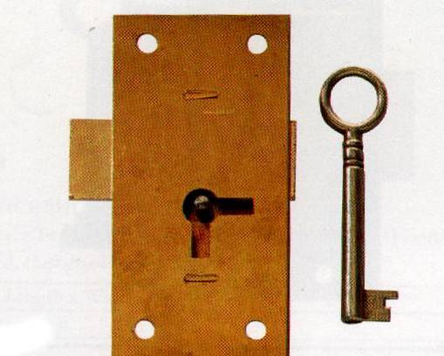
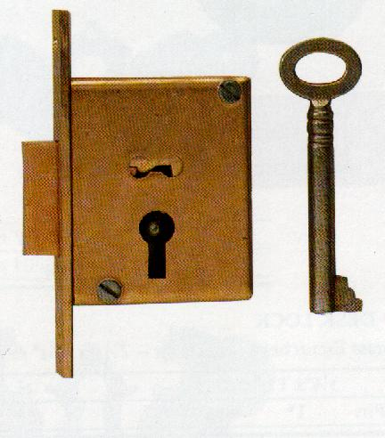
Straight Cupboard Lock
This lock can be used on all kinds of Cabinet doors. In fitting, cutting away of the wood is not necessary, the lock being lined up with the keyhole and screwed in position.
Mortise Lock
Can be used on doors or drawers. The timber is mortised to receive the body of the lock and the faceplate is let in flush with the surface, presenting a very neat appearance.

Slide 4
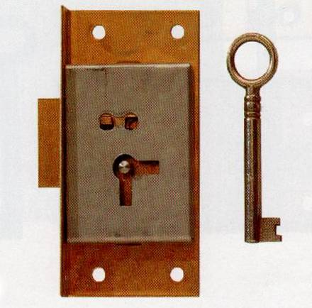
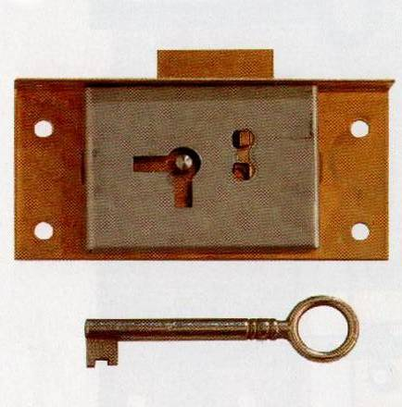
Cut Cupboard Lock or Till Lock
This is the traditional cabinet lock used to secure drawers and cupboards. Cabinet locks are often made with two keyholes at right angles to each other so they can be mounted horizontally or vertically.
Till Lock / Drawer Lock

