Slide 1
Adhesives

Slide 2
Dermatitis
Dermatitis is an inflammation of the skin usually starting with irritation and redness.
Blisters may appear and when these break septic infection is liable to occur. Dermatitis is, however, not contagious.
Occupational Dermatitis is caused by contact of the skin with certain materials. The hands and arms are usually affected first.
Protection in the form of rubber gloves or barrier creams and general washing.

Slide 3
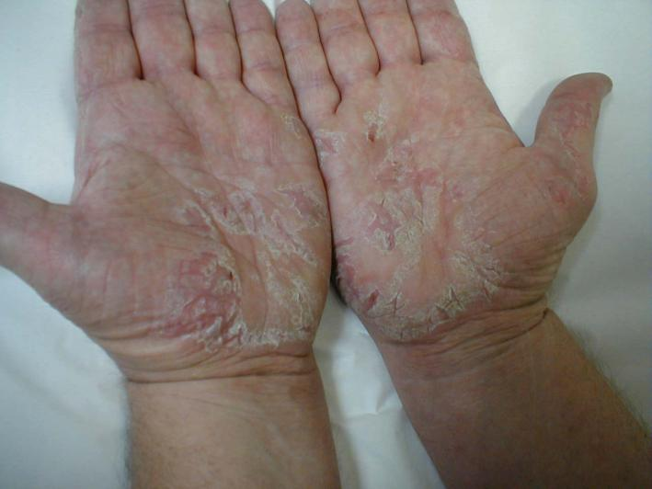
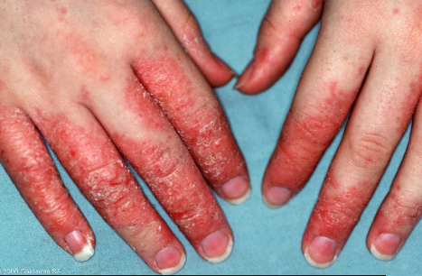
Dermatitis
Mild form of Dermatitis
If left untreated or you continue to use
product without protection condition can
become much worse see below

Slide 4
Adhesives
Glues are part of a larger family called adhesives.
The two classes are distinguished by the fact that glue comes from organic compounds while adhesives are chemical-based.
Three main types of glues / adhesives
Animal Glue : (animal bones & hide & fish offal )
Vegetable Glue : (starch, dextrine, rye, cellulose, soya bean flour & rubber latex)
Mineral Glue : (synethic resins, coal tar & crude oil)

Slide 5
Animal Glue History
The use of animal collagen glue has been traced back over 8000 years, with the discovery of artefacts in caves near the Dead Sea which were found to contain this material as an adhesive.
Egyptians used collagen glues 4000 years ago.
Records show that large glue factories were established in Europe at the end of the 17th century and America at the beginning of the 19th century.
This glue was the only glue used by furniture makers until the start of the 20th century then the development of synthetic adhesives began to change this.

Slide 6
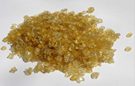
Animal Glue
American furniture makers started using new synthetic glues, while England and Europe continued to use Animal glue until well after the second World War.
Today, traditional animal glues are still used by antique restorers, museum conservators and musical instrument makers and restorers.
This glue must be heated in a glue pot & applied hot. Available in slab, pearl, granules or powder.
Animal glue:
Pearl form
Image from
Wikipedia

Slide 7
Animal Glue
Animal glues are derived from casein, hide, bone collagen & blood albumen . All of these adhesive products are organic in nature and non toxic to humans.
Advantages of Animal Glue Strong. Great for curved veneering. Veneer can be re-softened and when set and repositioned. Glue can be reheated and reused again. Cheap.
Disadvantages of Animal Glue Has to heated before use and applied hot. Can be quite pungent. Short pot life. Quite messy. Not waterproof.

Slide 8
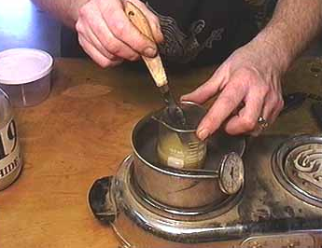
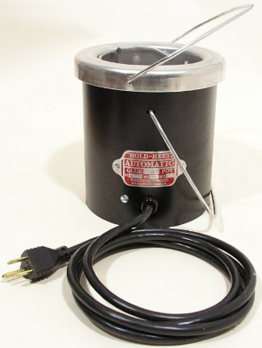
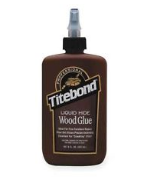
Animal Glue Pot
Traditional
Glue pot
Used over
Heat source
Modern electric glue pot opposite
Bottled liquid hide glue below

Slide 9
Vegetable Glue
Vegetable Glue : is made from the starch, gum and grains in vegetables and plants.
They are ground down and remixed with water to form a glue.
They have no real strength and were used for laying material.
Also used on paper tape.
Rubber latex glue is mixed with a solvents and sets by evaporation. They are used for leather work and upholstery and laying veneers and laminates.

Slide 10
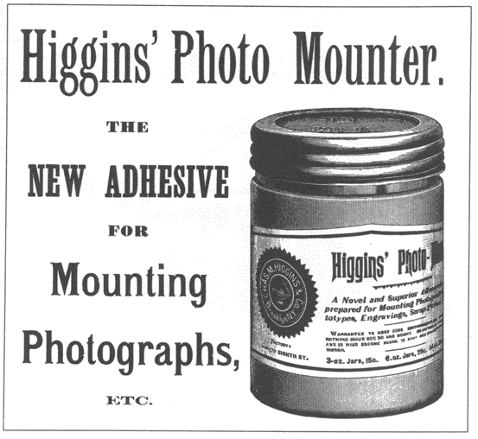
Vegetable Glue
Advertisement for Higgins' Photo Mounting Paste, 1894, described by the manufacturer as "not a starch or flour paste, but a vegetable glue.“
Used in the 19th Century for mounting Photos.

Slide 11
Adhesives
In the 1930’s advances in the chemical and plastics industries led to development of a wide range of materials called adhesives and plastic or synthetic resin glues.
World War II led to further developing of adhesives such as neoprene's, epoxies, and acrylonitriles.
These were used by the military and were not available for commercial use until the late 1940s or 1950s.
Adhesives are constantly being developed to make them water proof, quicker curing time or longer open time, gap filling, non staining & non toxic etc.

Slide 12
Mineral Glue
The adhesive industry is huge not just for furniture but in everyday living from the shoes we wear to the vehicles we travel in to packaging to the books we read.
Urea formaldehyde (U.F.) : Used in manmade boards eg. M.D.F, chipboard & O.S.B.
Advantages of Urea Formaldehyde Strong, Water resistant, Setting times can be speeded up with heat, great for pattern veneering, when set it is heat resistant
Disadvantages of Urea Formaldehyde Expensive, has to be weighed and mixed. Can cause allergic reactions i.e. Dermatitis, Short pot life, dulls tool edges, fairly short shelf life.

Slide 13
Mineral Glue
Phenol formaldehyde : Used for making plywood and Laminated plastics.
Resorcinol formaldehyde : Glue-lam beams found in leisure centres, shopping centres etc.
Epoxy resin : These glues are two creams that have to be mixed together before use. Some brands are sold in a double syringe that expels equal amounts of both creams. Used bonding non porous material metal, glass, plastic & wood.
Impact / Contact glues (Neoprene): These are either synthetic or natural rubber latex glues in solvents and set by evaporation. Used for laying veneers on shaped rims, laying plastic laminates.

Slide 14
Laying plastic laminate on chipboard.
Apply contact adhesive to the chipboard allow 10mins until its tacky.
Apply contact adhesive to the laminate and to the chipboard and leave until both become tacky
Position laminate on chipboard then press firmly expelling all air.
Leave until set then trim.
Health & Safety
This adhesive is highly flammable so safety precautions are needed when using i.e. no naked flame, good ventilation.
Fumes can cause burning to eyes and respiratory system so a mask and goggles should be worn for prolonged use.

Slide 15
Polyvinyl acetate (P.V.A.) :
Available interior and exterior grade for all types wooden joints.
Advantages of P.V.A. Glue Strong. Use straight from bottle. Exterior grade is water resistant. In veneering setting times can be speeded up with heat.
Disadvantages of P.V.A. Glue Some grades take up to 1hr to set. If not cleaned off properly orange staining can occur when polishing. Reacts with metal and tannic acid in certain timbers to give blue staining.

Slide 16
Adhesives Terminology
Glues cannot be intermixed because they set by different methods.
Solidify : Liquid to solid. Animal glue is applied as a hot liquid and sets as it cools down.
Evaporation: The solvent in some glues evaporates leaving the glue behind.
The water in PVA dries out leaving the glue to set.
Chemical reaction: When the urea (powder) and the formaldehyde (resin) are mixed a chemical reaction occurs and a bond is formed.
Heat is sometimes used to speed up the process of curing it dose not cause the curing.

Slide 17
Adhesives Terminology
Synthetic resins are either gap filling the glue needs to fill in the gaps without breaking down at a later stage.
Or veneering (close contact) glues.
Separate application glues: these glues are used with a catalyst or hardener its only function is to control setting time. Coat one side with glue one side with hardener
Mixed application glues : liquid or powder glue and hardeners are weighed and mixed prior to application. eg. U.F. glue for veneering – curing time is speeded up with heat.
Some glues like Cascamite are already premixed and by adding water the chemical process starts and the glue starts to set.

Slide 18
Adhesives Terminology
Glues should be used at room temperature of 18º. If glue is used in cold or freezing conditions failure of the glue may occur.
Chilling is were a skin is formed on the outer part of the wet adhesive. Bonding does not take part with the other component because the skin prevents this from happening.
Orange staining occurs with some types of glues, if the surplus glue is not cleaned off the surface of the wood properly then it reacts with the finish that is applied at a later stage.
Blue staining is the result of a reaction between the water in the glue, tannin in the wood and metal. Occurs during cramping if surplus glue is not cleaned off.

Slide 19
References
http://www.wpatrickedwards.com/gluearticle.htm
http://www.madehow.com/Volume-5/Glue.html

